Slide 1
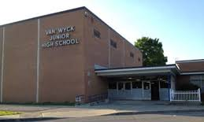
Welcome to Summer Reading 2020!
Hey y’all! Mrs. Green here!
Greetings! Mrs. B here!
Click PRESENT to begin!

Slide 2
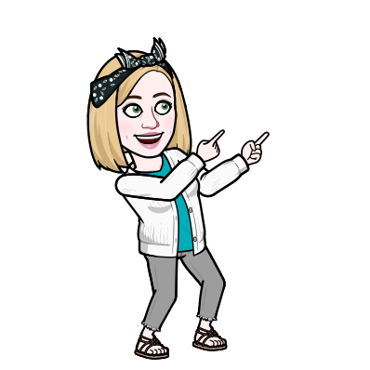
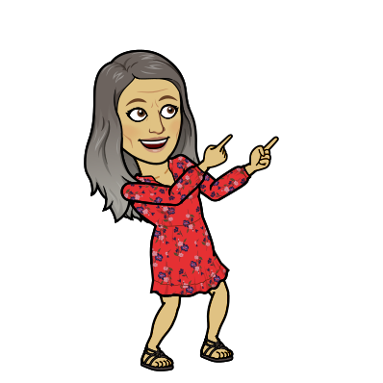
Click HERE to hear from Mrs. B and Mrs. Green!
Please be sure to go through the entire presentation to get all the information you need to keep on reading through summer!

Slide 3
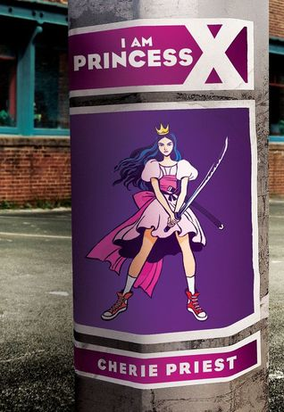
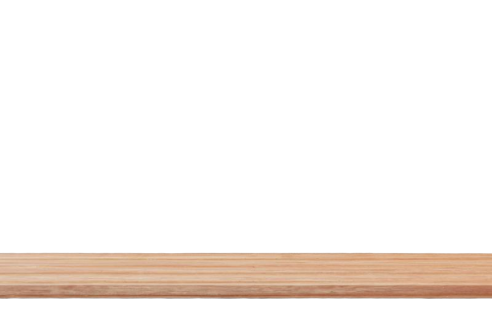
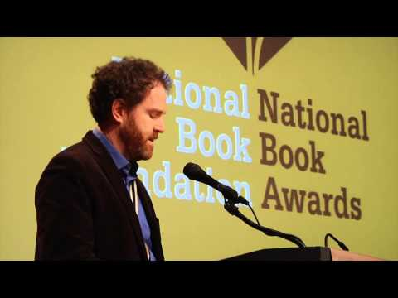
Click on a book cover to hear about it from a junior high librarian!

Slide 4
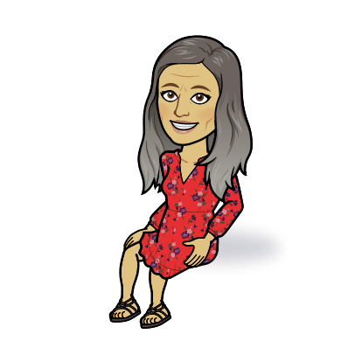
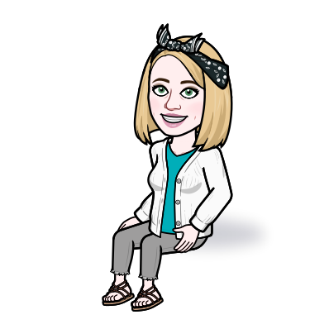
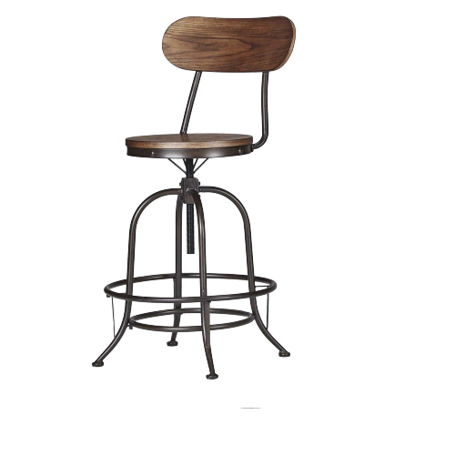
Mrs. B and Mrs. Green here! We wanted to share some booktalks and links with you for your summer reading!

Slide 5
If NOT, go HERE to register for one (online), and then you'll be able to access FREE eBooks!
FIRSTLY, do you have a PUBLIC library card?

Slide 6
The LIBBY and HOOPLA apps are what the public libraries use to access eBooks and other digital resources. Download one (or BOTH) to your device.

Slide 7
After adding the app(s), make sure to add your library card number. Once you've done that, you can check out eBooks, request holds for others, AND check out movies!

Slide 8
Another GREAT site to go to for free eBooks is TeenBookCloud!
Username: tumble2020 Password: A3b5c6

Slide 9
There are some GREAT audiobooks on Audible!

Slide 10
Feel free to reach out to either of us if you need help with any of the eBook resources we shared with you!
We hope you have a WONDERFUL summer!

